Slide 1
CSE1004:Network & Communication
Module : Cryptography
Dr. S.L.Jayalakshmi
VIT Chennai

Slide 2

Cryptography
VIT Chennai

Slide 3
Learning Objectives
Types of Cryptographic techniques
Components of Cryptographic techniques
Principles of Cryptographic techniques
Symmetric-key Cryptography : Traditional ciphers (character-oriented) and Modern Symmetric-key Ciphers (Block oriented)
Asymmetric-key Cryptography : RSA & Diffie-Hellman Key Exchange Algorithm

Slide 4

What is Cryptography?
A technique allows a sender to disguise data
so that, an intruder can gain no information from the intercepted data
The receiver, of course, must be able to recover the original data from the disguised data.
Cryptography : Greek origins means, The art of secret (crypto) message (graphy) writing

Slide 5
Need for Cryptographic Technique
Alice
Bob
The Network Security is mostly achieved through the use of cryptography
a network conversation may be compromised by an adversary. e.g. to obtain your credit card information - solution: ensure confidentiality
the customer is unknowingly being directed to a false website – e.g. translating a correct URL into an incorrect IP address - the owner of the website can be attacked as well - solution: provide authentication
MSG
MSG
Eve
Alice
Bob
MSG
MSG
Eve

Slide 6

Principles of Cryptographic Techniques
Sender
Receiver
Plaintext
Ciphertext
Plaintext
Encryption
Decryption

Slide 7
Components of Cryptographic Techniques
Plaintext : The original message, before being transformed
Ciphertext : After the message is transformed in an encrypted form
Encryption : Process of converting plaintext into ciphertext
Decryption : Process of converting cipher text into plaintext
Key : A key is a number (or a set of numbers) that the cipher, as an algorithm, operates on.
To encrypt a message : Need an encryption algorithm – Input : an encryption key, and the plaintext - Output: Ciphertext
To decrypt a message : Need a decryption algorithm – Input: a decryption key, and the ciphertext – Ourput: The original plaintext

Slide 8
Two Categories of Cryptography
Cryptography
Symmetric Key
Asymmetric Key
Symmetric key also called Secret-key Asymmetric key also called Public-key

Slide 9

Principles of Symmetric Key Cryptographic Techniques
Alice
Shared Secret Key
Bob
Plaintext
Ciphertext
Plaintext
Encryption
Decryption

Slide 10

Principles of Asymmetric Key Cryptographic Techniques
Alice’s public key & Private key
Bob’s public key & Private key
Alice
Bob
Plaintext
Ciphertext
Plaintext
Encryption
Decryption

Slide 11
Keys
Three types of keys: secret key, private key and public key
Secret key – shared key used in symmetric-key cryptography
Private key and Public keys used in asymmetric-key cryptography
Key – a value works with cryptographic algorithm - really, really, really very big number
Larger keys – cryptographically secure for a longer period
Public key – derived from private key

Slide 12
Comparison
Encryption - electronic locking; decryption - electronic unlocking
difference – mechanism of locking and unlocking and the type of keys used
Symmetric-key cryptography : same key locks and unlocks the box
Asymmetric-key cryptography: one key locks the box and another key unlocks the box

Slide 13
Ciphers – Two Types
Ciphers can be distinguished into two types by the type of input data
Ciphers
Stream Ciphers
Block Ciphers
Stream Ciphers : An encryption algorithm - encrypts 1 bit or byte of plaintext at a time
Block Ciphers : An encryption algorithm - encrypts a fixed size of n-bits of data - known as a block at one time (64 bits, 128 bits, and 256 bits, 1024 bits)

Slide 14
Symmetric–key Cryptography
VIT Chennai

Slide 15
Symmetric-key Cryptography
Started thousands of years ago – needed to exchange secrets (e.g. in war)
Still mainly use in our network security
Traditional ciphers (character oriented) and Modern ciphers (block oriented)
Traditional ciphers : Substitution ciphers and Transposition ciphers

Slide 16
…Symmetric-key Cryptography
Traditional cipher: Substitution cipher
Substitute one symbol with another
If the symbols in the plaintext are alphabetic characters, replace one character with another
If the symbols are digits (0 to 9), replace one number with another number

Slide 17
…Symmetric-key Cryptography
Substitution cipher : Monoalphabetic cipher
a character (or a symbol) in the plaintext - changed to the same character (or symbol) in the ciphertext regardless of its position in the text
One – to –one relationship between plaintext and ciphertext
E.g. : Plaintext : HELLO Ciphertext : KHOOR Is the cipher monoalphabetic cipher?
Yes, probably monoalphabetic because both occurrences of L's are encrypted as O's

Slide 18
…Symmetric-key Cryptography
Substitution cipher : Monoalphabetic cipher
Shift cipher – a simple monoalphabetic cipher
Plaintext and Ciphertext – only Uppercase letters
Encryption algorithm : ‘Shift key characters down’
Decryption algorithm : ‘Shift key characters up’
Key – equal to a number
Referred to as Caesar cipher – Caesar used a key of 3
characters down – towards the end of the alphabet characters up – towards the beginning of the alphabet If you reach the end or beginning of alphabet, wrap around

Slide 19
…Symmetric-key Cryptography
Monoalphabetic cipher – Shift cipher
Use the shift cipher with key = 15 to encrypt the message “HELLO”
H
W
E
T
This is the encrypted message
L
A
L
A
To decrypt, each character is shifted to 15 characters up
O
D

Slide 20
…Symmetric-key Cryptography
Substitution cipher – Polyalphabetic cipher
each occurrence of a character can have a different substitute
One-to-many relationship
Divide the text into groups of characters
Use a set of keys
Playfair and Vigenere Cipher – well known polyalphabetic ciphers

Slide 21

…Symmetric-key Cryptography
Polyalphabetic cipher – Vigenere Cipher
Plaintext : ATTACKATDAWN
Key : LEMON
What is the Ciphertext?
A T T A C K A T D A W N
L E M O N L E M O N L E
L X F O P V E F R N H R
This is the cipher text
Vigenere Square

Slide 22
…Symmetric-key Cryptography
Transposition cipher
There is no substitution of characters; instead, their locations change
reorders (permutes) symbols in a block of symbols
key - mapping between the position of the symbols in the plaintext and cipher text

Slide 23
…Symmetric-key Cryptography
Transposition cipher - Example
Key mapping :
plaintext 2 4 1 3
ciphertext 1 2 3 4
Encrypt the message “HELLO MY DEAR”
Solution
Remove the spaces in the message
Divide text into blocks of 4 characters
Add bogus ‘Z’ at the end of 3rd block
Apply key mapping to get ciphertext
1234 1 2 34 1234
HELL OMYD EARZ
ELHL MDOY AZER
Encrypted message
encryption applies it from downward while decryption applies it upward

Slide 24

…Symmetric-key Cryptography
Simple Block Cipher
Ciphers need to be bit oriented
Information – not just text – may be numbers, audio, video, graphics data
convert them into a stream of bits, encrypt the stream, and then send the encrypted stream
Mingling and mangling bits provides more security than characters - each character is replaced by ‘n’ bits
To achieve goal – uses several simple ciphers

Slide 25

…Symmetric-key Cryptography
Simple Block Cipher – XOR Cipher
Two data inputs - Block to be encrypted and a key
Size of the key, plaintext and the ciphertext – all are same
Important property : Encryption and Decryption are the same
Input bits
Output bits

Slide 26
…Symmetric-key Cryptography
Input bits
Simple Block Cipher – Rotation Cipher
Inputs bits – rotated to the left or right
It can be keyed or keyless
Keyed rotation – key value : number of rotations
Keyless rotation – key value : fixed number of rotations
Special case of transpositional cipher : use bits instead of characters
Number of rotations – between 1 and N-1
Decryption algorithm : opposite rotation direction
Output bits

Slide 27
…Symmetric-key Cryptography
N Input bits
Simple Block Cipher – Substitution Cipher : S Box
Substitution box– Input : Stream of bits with length N
Output : another stream of bits with length M
Length N and M – are not necessarily same
Keyless – used as an intermediate stage of encryption or decryption
Function may be defined mathematically or by a table – matches the input to output
A function that matches N inputs to M outputs
M Output bits

Slide 28
…Symmetric-key Cryptography
Simple Block Cipher – Transposition Cipher : P Box
It transposes bits
Can be implemented in software or hardware
Hardware is faster
Normally keyless, like S-Boxes
Three types of permutations: Straight, Expansion, Compression

Slide 29
…Symmetric-key Cryptography
Simple Block Cipher – Transposition Cipher : P Box
Straight
Expansion
Compression

Slide 30
…Symmetric-key Cryptography
Simple Block Cipher – Modern Round Ciphers
Involve multiple rounds
Each round – complex ciphers made up of simple cipher
Key for each round – subset or variation of the general key called Round key
If cipher has N rounds – a key generator produces N keys, K₁, K₂, … K_{N} where K₁ used in round 1, K₂ in round 2 and so on

Slide 31
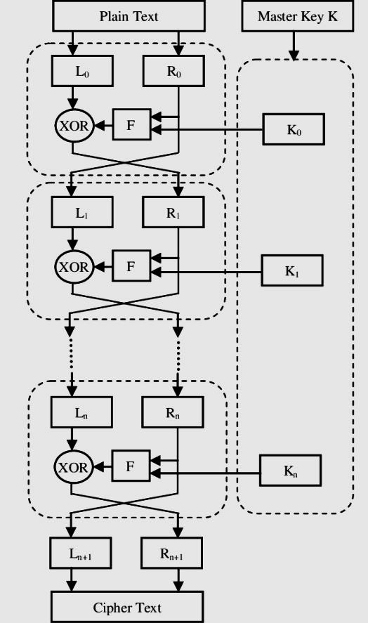
…Symmetric-key Cryptography
Simple Block Cipher – Modern Round Ciphers

Slide 32
…Symmetric-key Cryptography
Modern Symmetric Ciphers
Few modern symmetric ciphers – Block oriented
Data Encryption Standard (DES)
Triple Data Encryption Standard (Triple – DES)
Advanced Encryption Standard (AES)
International Data Encryption Algorithm (IDEA)
Blowfish

Slide 33
Asymmetric–key Cryptography
VIT Chennai

Slide 34
Asymmetric-key Cryptography
Also known as Public Key Infrastructure (PKI)
Pair of keys : Public key – encrypts the data & Private key – decrypts the data
Computationally infeasible to deduce the private key from the public key
Anyone who has a public key can encrypt the data but cannot decrypt it
Only the person who has the corresponding private key can decrypt the data
solve key distribution problems

Slide 35
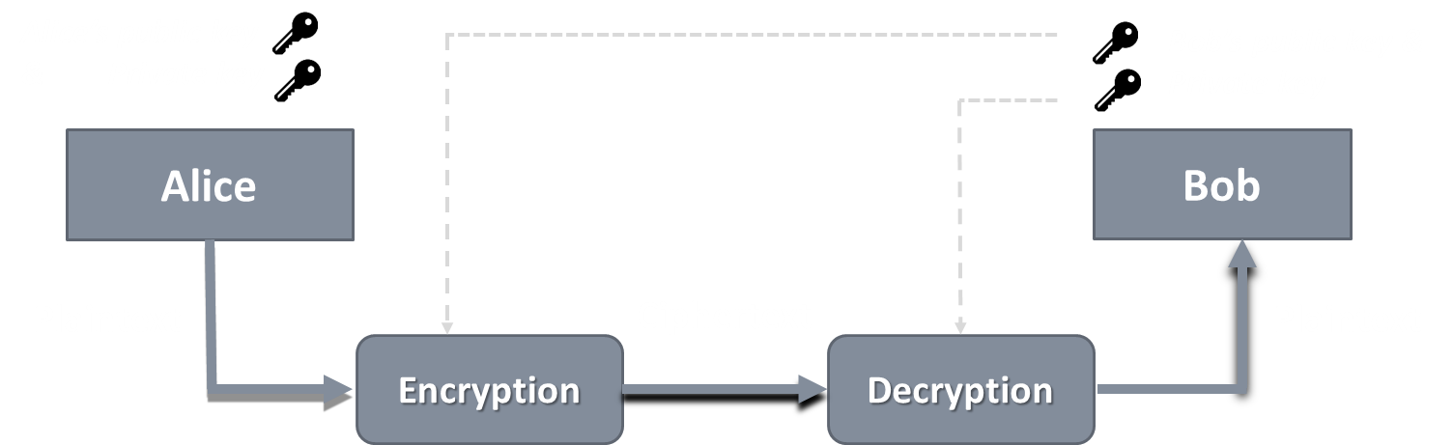
Applications
Encryption / Decryption

Slide 36
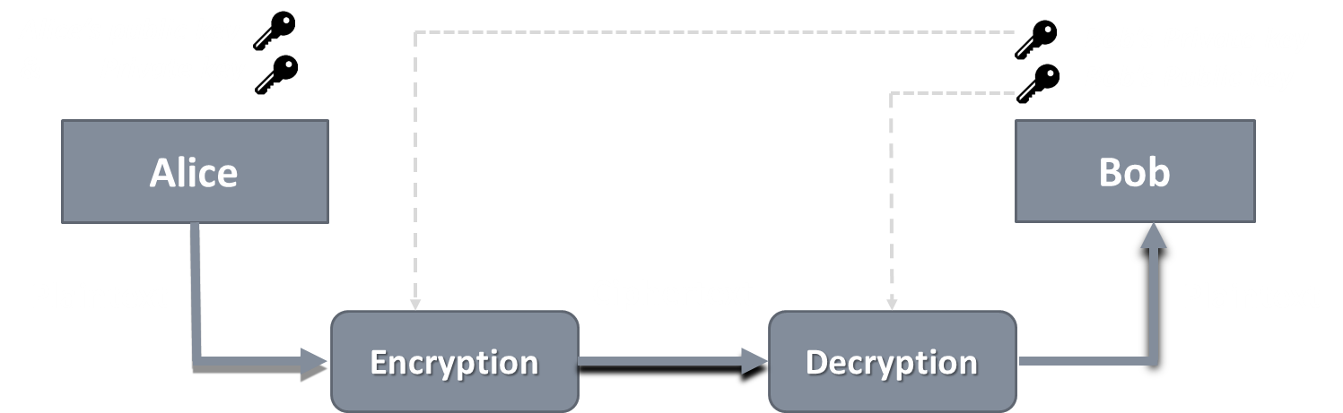
Applications
Digital Signature : Sender “signs” a message with its private key – ensures authentication
Key exchange: Two sides cooperate to exchange a session key / secret key – Diffie-Hellman Exchange Algorithm

Slide 37
RSA Algorithm
The most common public key algorithm- named for its inventors Rivest, Shamir, and Adleman (RSA) – year 1977
Block cipher scheme
Plaintext and ciphertext are numbers – between 0 and n-1 for some n
Typical size of n is 1024 bits (309 decimal digits)
Make use of an expression with exponentials
Having key generation algorithms, encryption and decryption algorithms

Slide 38
RSA Algorithm
Key Generation
p,q two prime numbers (private, chosen)
Compute n = pq; φ(n)=(p-1)(q-1) (public, calculated)
Select e, with gcd( φ(n), e) = 1; 1 < e < φ(n) (public , chosen)
Find d = e⁻¹ (mod φ(n)) (private, calculated)
Now, private key {d,n} public key {e,n}

Slide 39
RSA Algorithm
Encryption
User A
private key {d_{A}, n}
public key {e_{A},n}
Assume User A wants to send a message M < n
User B
private key {d_{B}, n}
public key {e_{B},n}
e_{B}
User B’s public key
_{Compute C=} _{M} e_{B mod n}
Ciphertext ‘C’

Slide 40
RSA Algorithm
Decryption
User A
private key {d_{A}, n}
public key {e_{A},n}
User B
private key {d_{B}, n}
public key {e_{B},n}
Ciphertext ‘C’
_{Compute M=} _{C} d_{B mod n}
Original Message sent by User A

Slide 41
RSA Algorithm
Example :Alice wants to send a message M=88 to Bob
Key Generation Process for Bob
p=17, q=11 two prime numbers
Compute n=pq =17*11=187; φ(n)=(p-1)(q-1)=16*10=160
e=7, with gcd( 160, 7) = 1; 1 < 7 < 160
d = 7⁻¹ (mod 160) i.e. e*d= 1 mod 160 7*23 = 1 mod 160 [Apply extended Euclid’s Algorithm]
Now, Bob’s private key {23,187} public key {7,187}

Slide 42
RSA Algorithm
Encryption
Alice
private key {d_{A}, n}
public key {e_{A}, n}
Alice wants to send a message 88 < 187
Bob
private key {23,187}
public key {7,187}
7
Bob’s public key
_{Compute C=} ₈₈ 7 _{mod 187}
Ciphertext ’11’

Slide 43
RSA Algorithm
Decryption
Alice
private key {d_{A}, n}
public key {e_{A},n}
Bob
private key {23, 187}
public key {7,187}
Ciphertext ‘11’
_{Compute M=} ₁₁ 23 _{mod 187}
Original Message M=88 sent by Alice

Slide 44
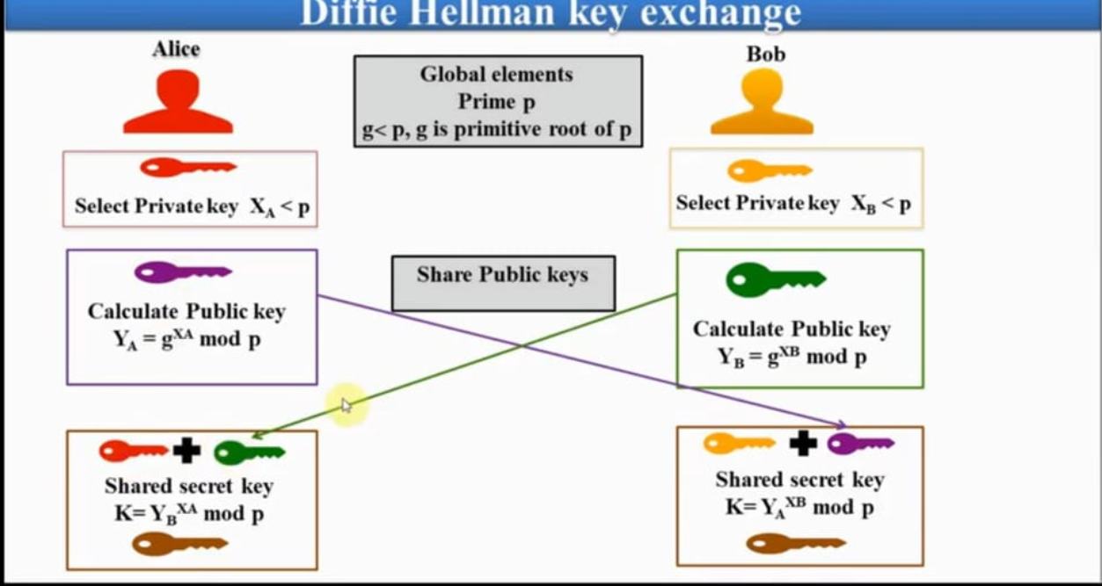
Diffie-Hellman Key Exchange Algorithm

Slide 45
Diffie-Hellman Key Exchange Algorithm
Global Public Elements
q Prime number α α < q and α a primitive root of q
User A Key Generation
Select XA XA<q Calculate YA YA=α^{XA} mod q
User B Key Generation
Select XB XB<q Calculate YB YB=α^{XB} mod q
YB
YA
Secret key generation K = (YB)^{XA} mod q
Secret key generation K = (YA)^{XB} mod q

Slide 46
Diffie-Hellman Key Exchange-Example
Global Public Elements
q=97 Prime number α=5 α < q and α a primitive root of q
User A Key Generation
Select XA=36 XA<q Calculate YA=5³⁶ mod 97
User B Key Generation
Select 58 XB<q Calculate YB=5⁵⁸ mod 97
YA =50
YB =44
Secret key generation K = (44)³⁶ mod 97=75
Secret key generation K = (50)⁵⁸ mod 97=75

Slide 47
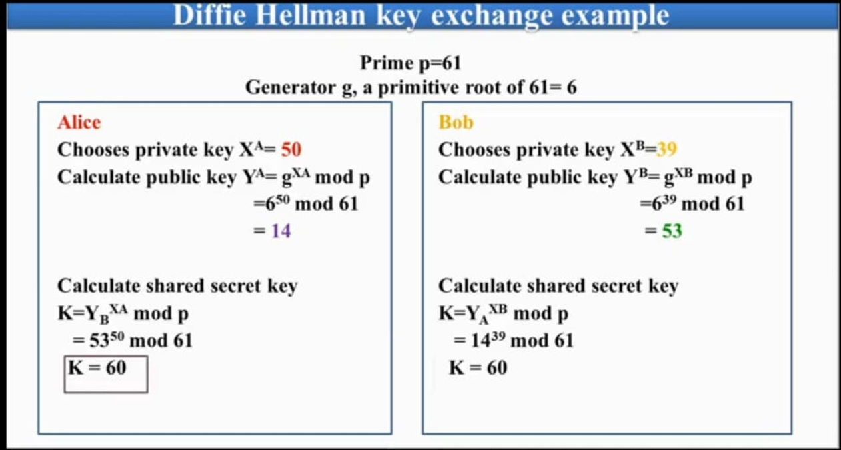

Slide 48
Additional Learning Resources
Data Communication and Networking, Behrouz A. Forouzan, McGraw Hill, 4th Edition
Cryptography and Network Security, William Stallings, Prentice Hall, 5th Edition
Cryptography and Network Security – Online NPTEL: https://nptel.ac.in/courses/106/105/106105031/

